Slide 1

FORMATTING WORD
Session 3

Slide 2

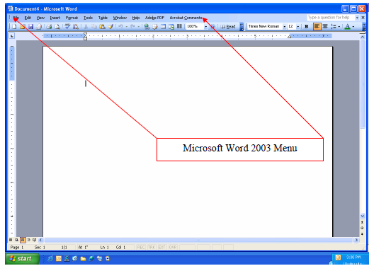
MAIN SCREEN OF A MICROSOFT WORD
The screenshot below is the opening screen for Microsoft Word 2003. Through this tutorial, we will review screenshots and documentation on how to navigate some of the basic menus and the steps necessary to format a basic paper correctly.

Slide 3

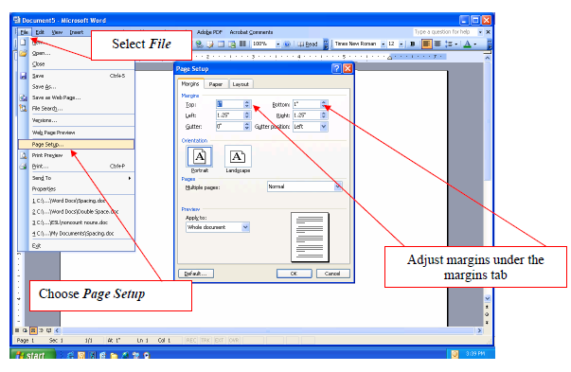
Page Setup and Margin Formatting
The screenshot beside displays the menu path to change the margins in a paper. According to APA, all margins are set at 1 inch.
Select page layout.
From the file dropdown menu, select Page Setup.
In the Page Setup window, the Margins tab will allow you to change the margins to the correct format.
When you are finished, click OK to return to your paper.

Slide 4

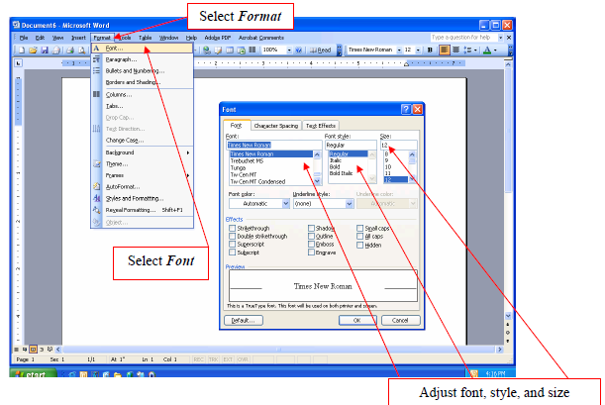
FORMATTING FONT
The screenshot beside displays the menu path to change the font. Use a traditional font such as Times New Roman or Courier in 12-point size.
Select Format.
From the format dropdown menu, select Font.
In the Font Setup window, the Font tab will allow you to adjust the font, style, and size to the correct format.
When you are finished, click OK to return to your paper.

Slide 5
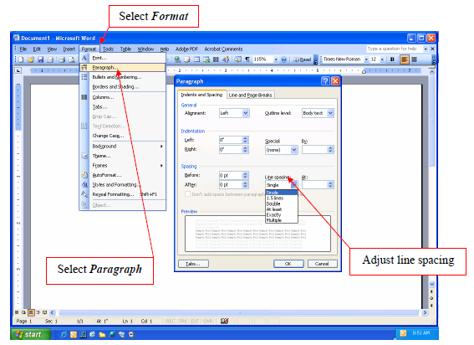
FORMATTING SPACING
The standard spacing format for a paper is double-spacing. Double-space the entire document, including the reference page. The screenshot beside displays the menu path to change the spacing format to double.
Select Format.
From the format dropdown menu, select Paragraph.
In the Paragraph Setup window, the Indents and Spacing tab will allow you to adjust the line spacing of your document.
When you are finished, click OK to return to your paper.

Slide 6
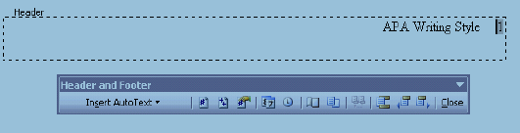
TO CREATE A CORRECT HEADER & FOOTER WITH A PAGE NUMBER IN WORD 2003
Select the View / insert menu on the toolbar.
Select Header and Footer.
Place the curser in the Header box and select the right justification button on Word’s toolbar so that the curser in the Header box moves to the right.
Type the first two or three words of the title.
Press the space bar five times.
Use the automatic function for inserting the page number as illustrated in this picture by selecting the first button with the # symbol.
Select Close. Your header is complete.

Slide 7

THANK YOU!
JONATHAN
WALLAS
Phone
075-620-1455
Email
jonathanwallas4@gmail.com

